Slide 1
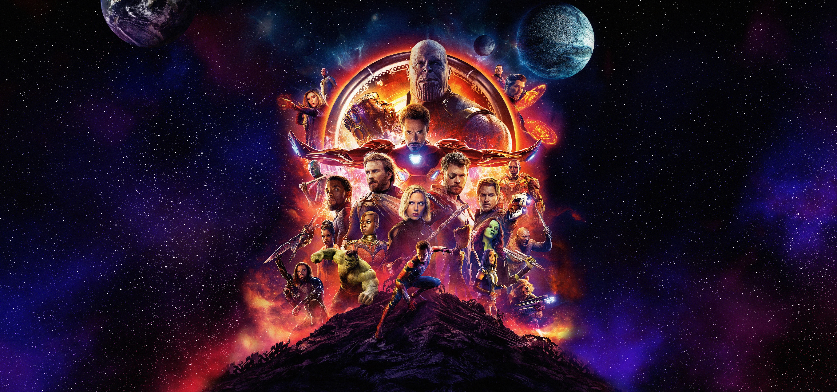
MARVEL
S T U D I O S

Slide 2
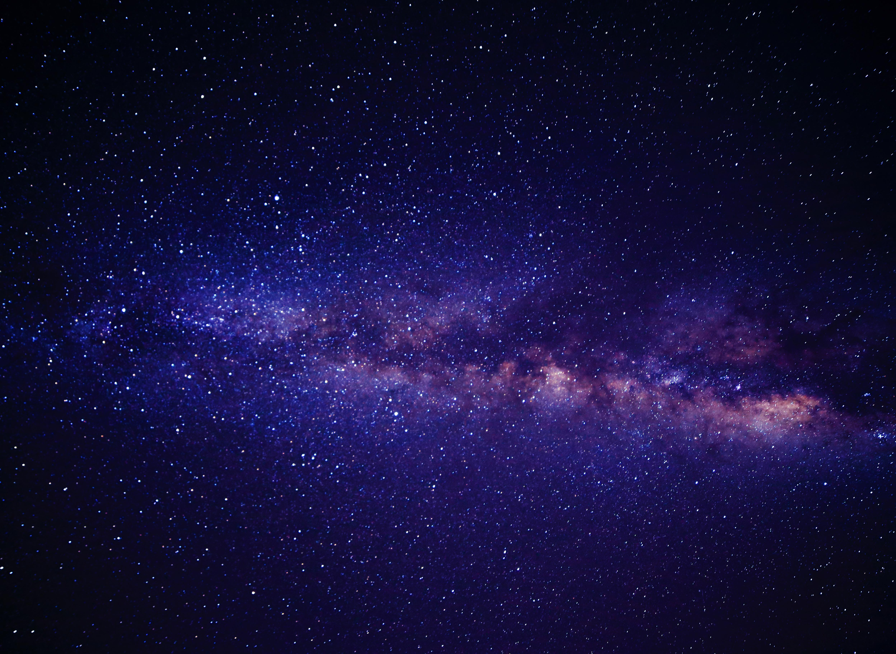


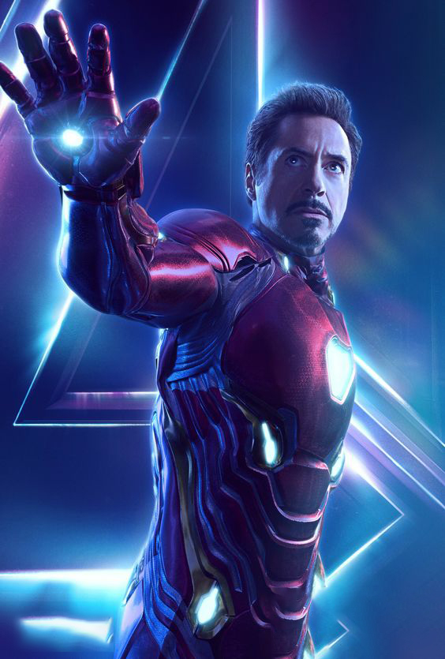
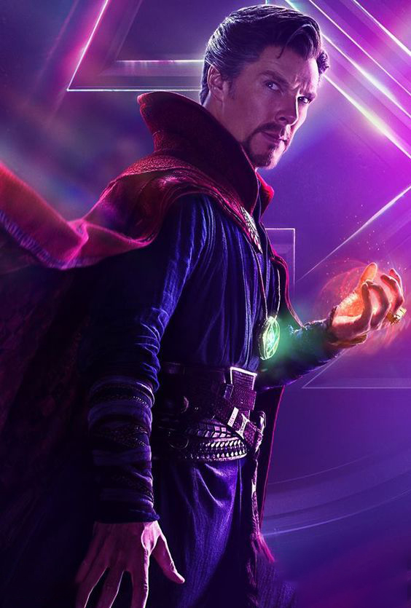
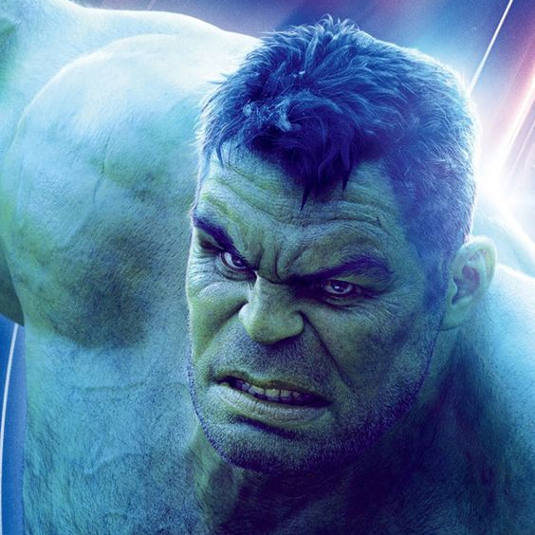

maayan birenboim
OUR TEAM
Alon Alboher
Maayan Birenboim
Vered Beeri

Slide 3
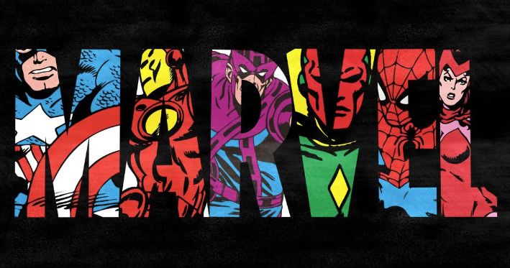
Introduction to Marvel Studios
Marvel Studios is a film production company known for creating the Marvel Cinematic Universe (MCU), a media franchise that includes interconnected superhero films and TV series. Founded in 1993 and a division of The Walt Disney Company since 2009, Marvel Studios has produced numerous blockbuster hits featuring iconic characters such as Deadpool, Spider-Man, and the Avengers. The MCU is celebrated for its elaborate storytelling, extensive character arcs, and crossover events, making it one of the most successful and influential film franchises in history.

Slide 4

Mcu TIMELINE
1993
2008
2009
2012-2019
2021
Marvel Films was established, focusing on producing films based on Marvel characters
The release of "Iron Man" marked the beginning of the MCU. The film's success laid the foundation for the interconnected universe of Marvel films.
Marvel Studios was acquired by The Walt Disney Company for $4 billion.
Creation of The Avengers, The MCU first superhero collaboration movie culminating in the resolution of the Infinity Saga, with "Avengers: Endgame" becoming one of the highest-grossing films of all time.
The launch of Phase Four on Disney+, marking Marvel's entry into television and streaming content.

Slide 5
The marvel universe in numbers
To truly understand the company, we need to start by asking some questions and presenting KPIs:
Do Marvel studios work in accordance with a production plan? If so, what is the plan?
How many productions did Marvel studios make and are they connected?
How much does Marvel studios spend on their productions?
Who is watching productions made by Marvel studios?
How much did Marvel studios earn from their productions?

Slide 6

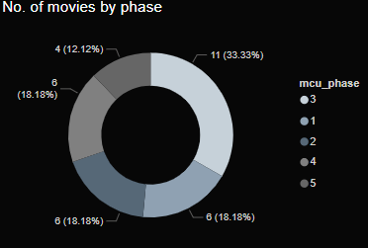
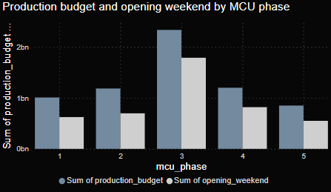
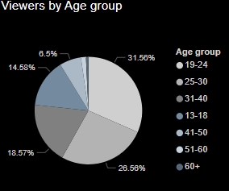
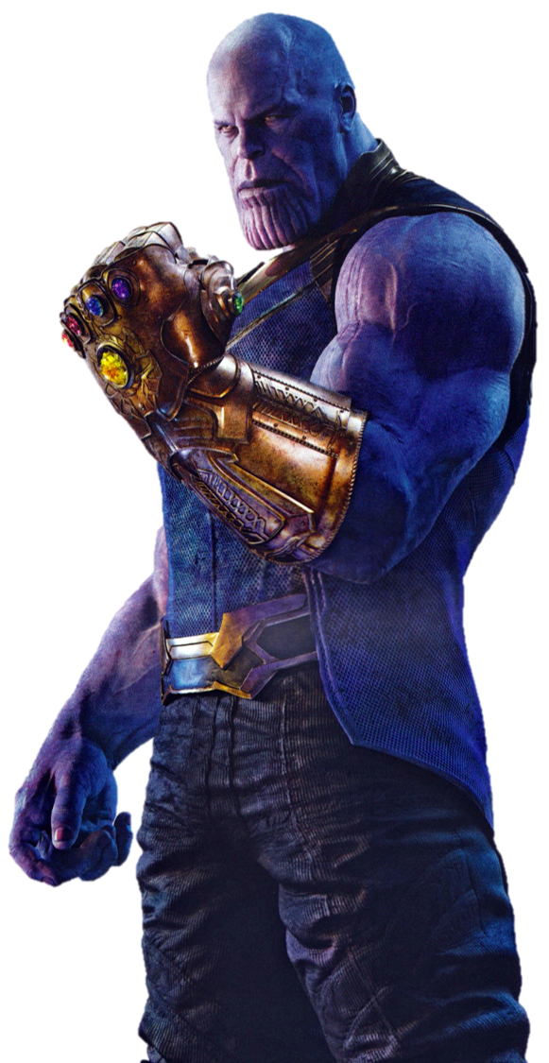
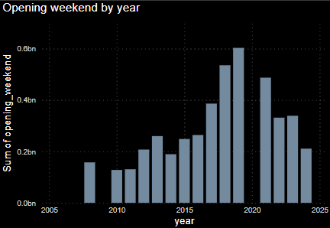
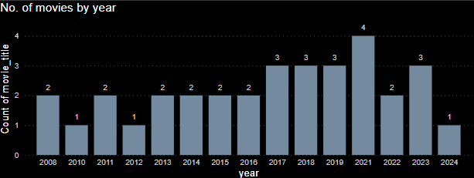
The marvel universe in numbers
33
Movies
5
*Phases
4,315
Total watch time (min)
7B Total production budget
4B
Total opening nights
42B Total box office revenue
81%
Avg. Tomato meter
*Marvel's cinematic universe is structured in phases, with each phase consisting of a series of interconnected films that advance the main storylines. Each phase builds upon the previous ones, adding to the ever-expanding and interconnected Marvel Cinematic Universe.
Phase 1 - Infinity Saga 2008 - 2012
Phase 2 2013 - 2015
Phase 3 2016 - 2019
Phase 4 - Multiverse Saga 2021 - 2023
Phase 5 2023-2025

Slide 7
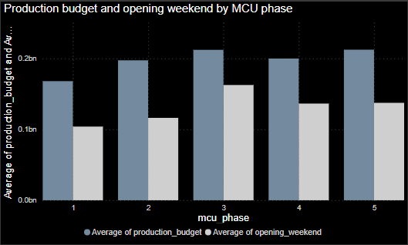
The marvel universe in numbers
33
Movies
5
Phases
4,315
Total watch time (min)
7BN
Total production budget
4BN
Total opening nights
42BN
Total box office
81%
Avg. Tomato meter
Phase 3 features the largest number of movies, with the highest average budgets and the greatest opening weekend earnings (phase 3: 2016 – 2019).
Phase 3 featured several highly anticipated films, such as Captain America: Civil War, Avengers: Infinity War, and Avengers: Endgame. These multi-superhero films had massive marketing campaigns and significant fan excitement.

Slide 8
The marvel universe in numbers
33
Movies
5
Phases
4,315
Total watch time (min)
7BN
Total production budget
4BN
Total opening nights
42BN
Total box office
81%
Avg. Tomato meter
The majority of viewers are aged 19-24, representing 31%, with those aged 25-30 coming next at 25% (Totaling 56% at 19-30).

Slide 9
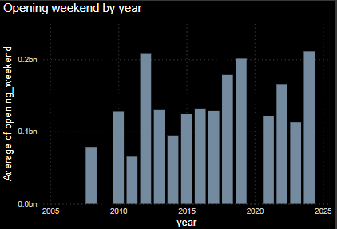
The marvel universe in numbers
33
Movies
5
Phases
4,315
Total watch time (min)
7BN
Total production budget
4BN
Total opening nights
42BN
Total box office
81%
Avg. Tomato meter
In 2012, 2019, and 2024, the highest average income for opening weekends was recorded.
These years featured highly anticipated films, including The Avengers, Avengers: Endgame, and Deadpool 3.
In 2021, despite of the highest number of movie releases, average opening night earnings were not among the top years, likely due to the pandemic, closing of Phase 3 with ‘Avengers: Endgame’ (2019), and a mix of lower-profile films.

Slide 10
The marvel universe in numbers – full Dashboard
33
Movies
5
Phases
4,315
Total watch time (min)
7BN
Total production budget
4BN
Total opening nights
42BN
Total box office
81%
Avg. Tomato meter

Slide 11
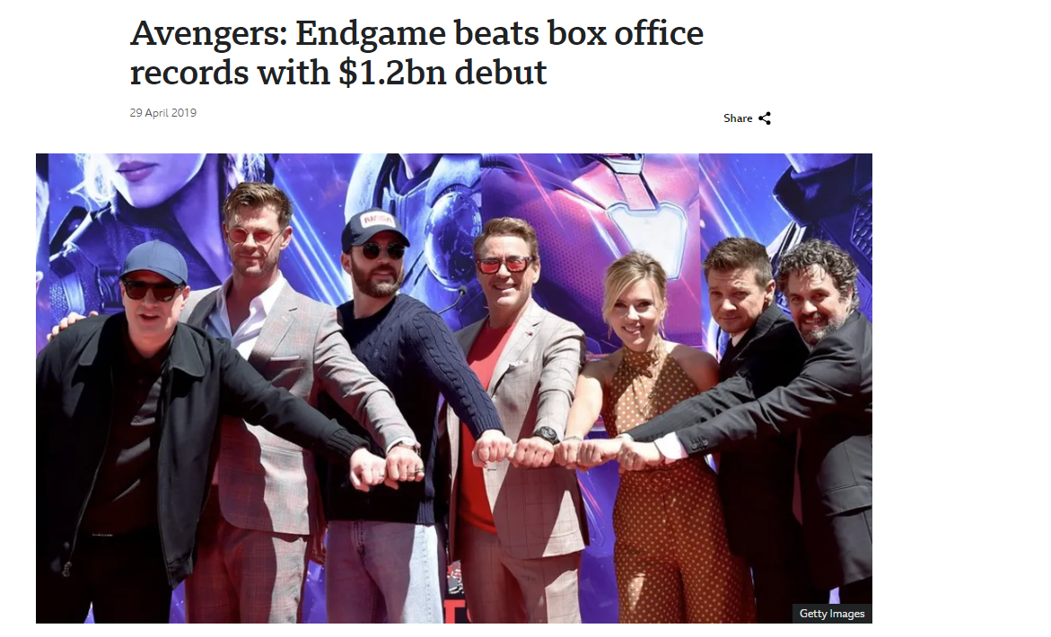
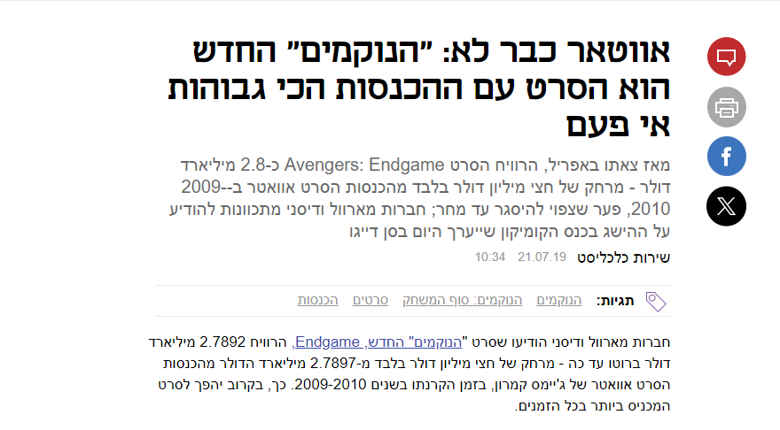
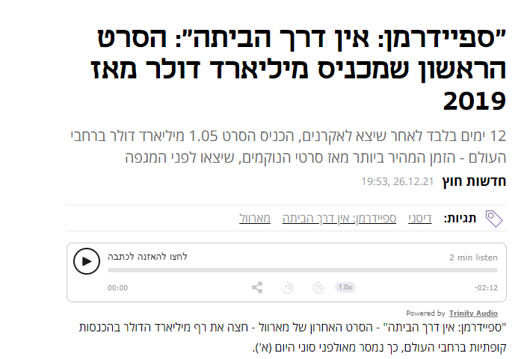
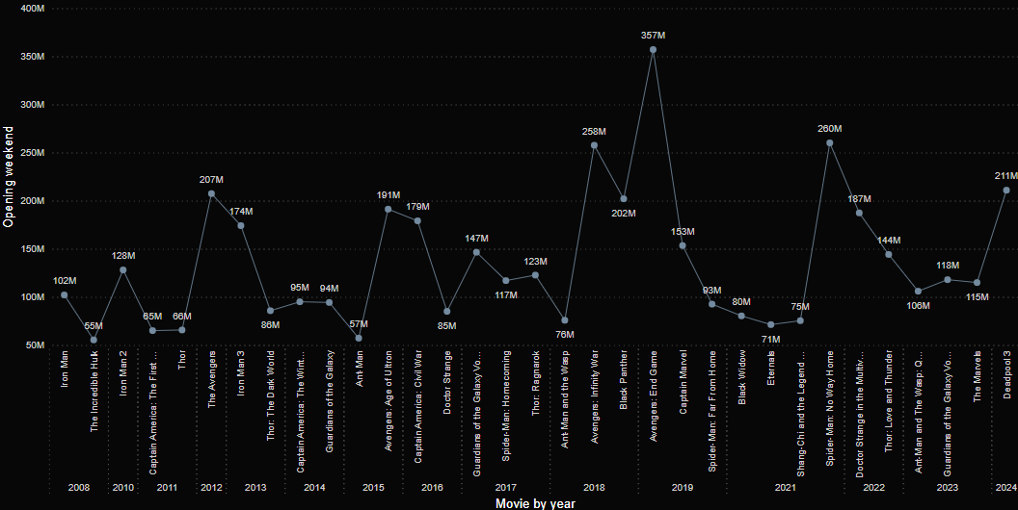
Opening weekend by movie
This graph illustrates the opening weekend earnings for Marvel movies over the years.
Highlighted in yellow are the top-grossing films, featuring multiple superheroes achieving the highest income during their opening week.

Slide 12
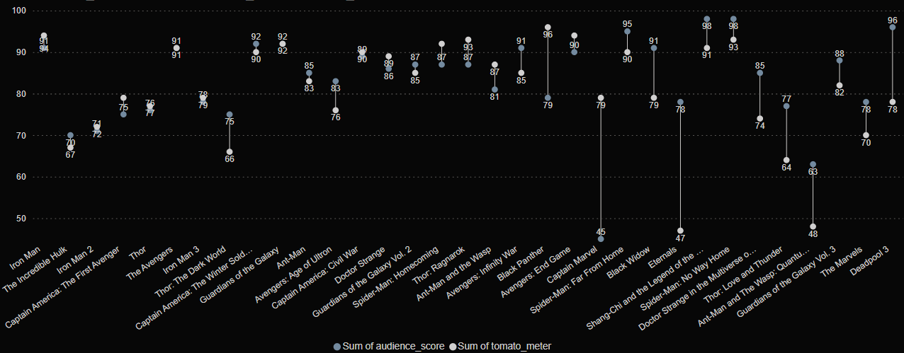
MCU audience vs. Rotten Tomatoes Scores
The yellow line cuts the graph in to two sections and represent a shift in the graph's pattern before and after “Thor: Ragnarök“ (2017 – beginning of Phase 3).
Following this film, there is a noticeable gap between audience and critic scores, likely because of the different expectations and preferences of the ever-growing audience & fan base.

Slide 13
The marvel universe in numbers
Midway analysis summery – introduction to Marvel studioes
Marvel studios work in a phase-based plan creating movie sagas that run across various timelines and universes. That approach proved successful with higher ratings and earnings for movies with multiple superheroes that are directly connected to the main story line.
Marvel created 33 movies in 5 phases and 2 major sagas (Infinity & Multiverse)
The total budget of all the movies was $7B
The majority of Marvel studious audience are viewers between the ages of 19-30 and the average of reviews (rotten tomatoes) place the studious movies above 80% on the tomato meter. Focusing on movies for that specific audience will keep Marvel studios earning more and with high ratings.
Marvel studios earned $42B on their movies thus far.

Slide 14
Marvel Studios in Social media
Our team has received a model of Marvel’s social media engagement.
We looked at a 100 of Marvel’s followers (users) activity on 257 Instagram posts (photos) between the dates of July 1st 2024, and July 7th 2024 (7 days).
We started from the basics looking at the numbers, average of likes/comments, user engagement, etc. and proceeded to more complex queries.

Slide 15
Marvel Studios in Social media
Before entering the research and analysis of Marvel studios social media, we present our KPIs:
Do Marvel studios invest most of its resources in the right social network?
At what time are posts usually posted?
What is the average engagement rate of Marvel studios social media?
What are the best times for Marvel studios to post with regards to their crowd?
What are Marvel Studios followers looking for in posts?

Slide 16
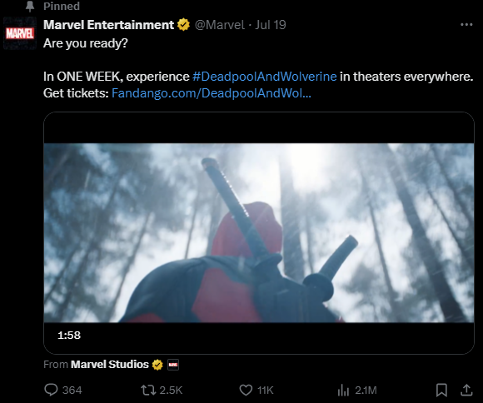
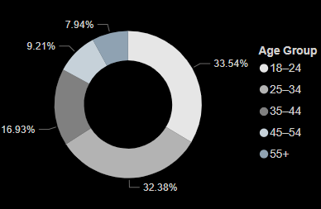

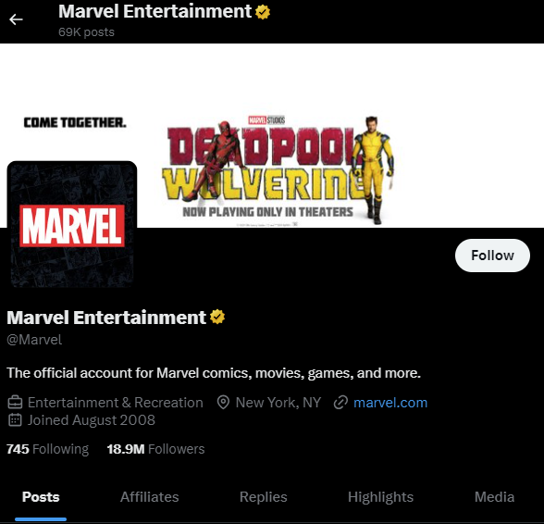
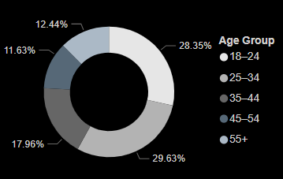

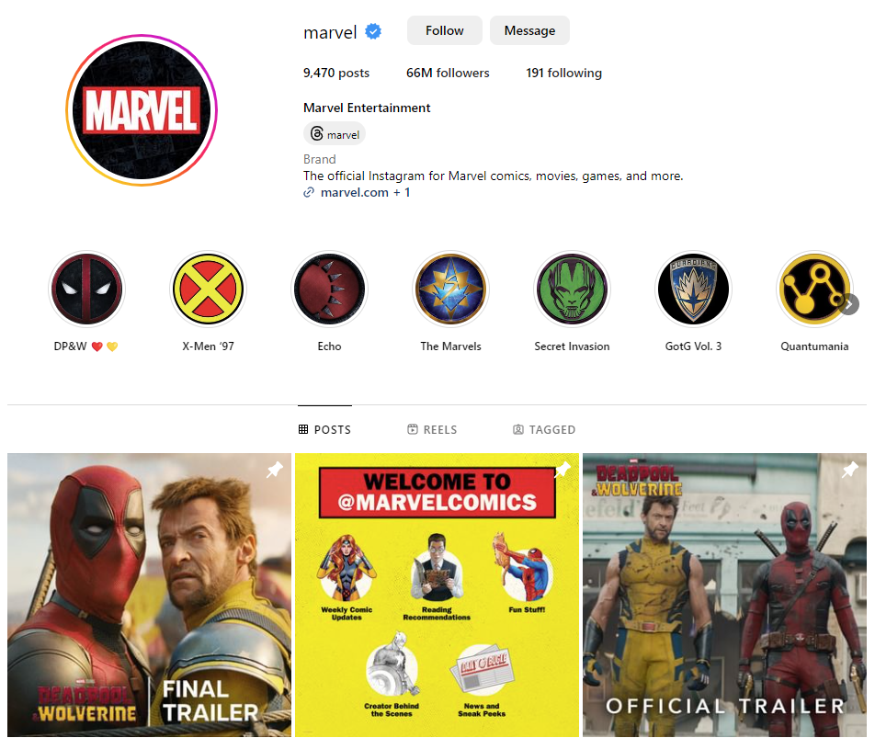
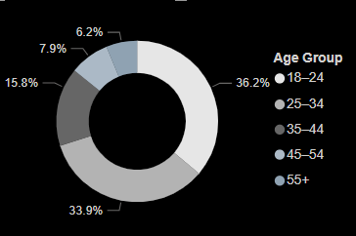

Marvel Studios in Social media
66M Followers
9,470 Posts
191 Following
18.9M Followers
69K Posts
745 Following
13.2M Followers
24 posts
0 Following

Slide 17
Marvel Studios in Social media
66M Followers
9,470 Posts
191 Following
18.9M Followers
69K Posts
745 Following
Marvel studious current biggest social investment is on X (formerly Twitter) with 69K posts (going on a few posts per day) and 18.9M followers, Instagram coming in second with less investment (9470 posts) but more followers (66M followers).
13.2M Followers
109.4K Likes
0 Following

Slide 18
Social media
66M Followers
9,470 Posts
191 Following
18.9M Followers
69K Posts
745 Following
Surprisingly, even thou the majority of MCU viewers are in the 19-24 age group, making up 31.56% of the audience. TikTok, where the largest demographic is 18-24 years old at 36% (compared to Instagram at 33.54% and X at 28.35%) is coming in last with only 24 posts and 13.2M followers. Based on this data, it is recommended that the MCU allocate more resources to TikTok to better target this key audience segment.
13.2M Followers
109.4K Likes
0 Following

Slide 19
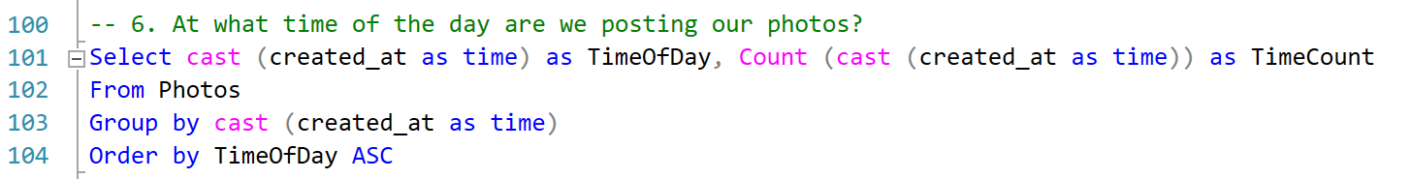

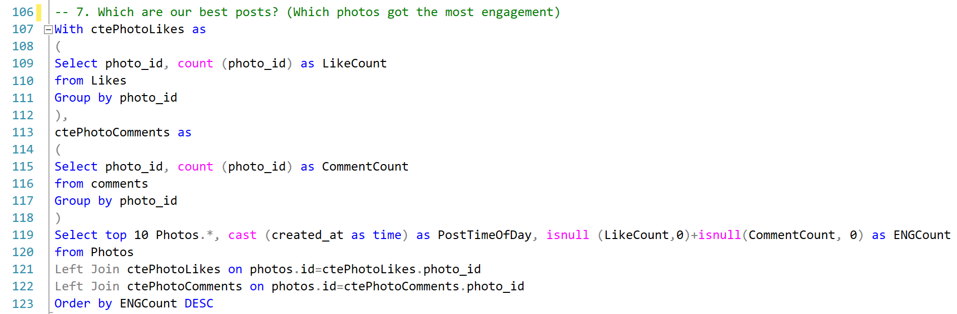
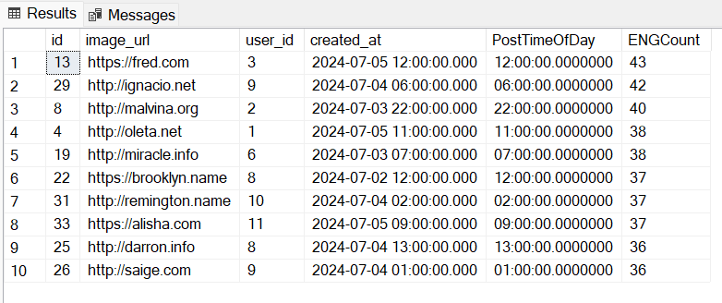
MARVEL Social media ANALISYS
Some of the starting quaries that we used while researching Marvel studios social media engagement.
*This are the top 10 times, there are other times not mentioned in this chart that total in less then 55% precent of the data

Slide 20
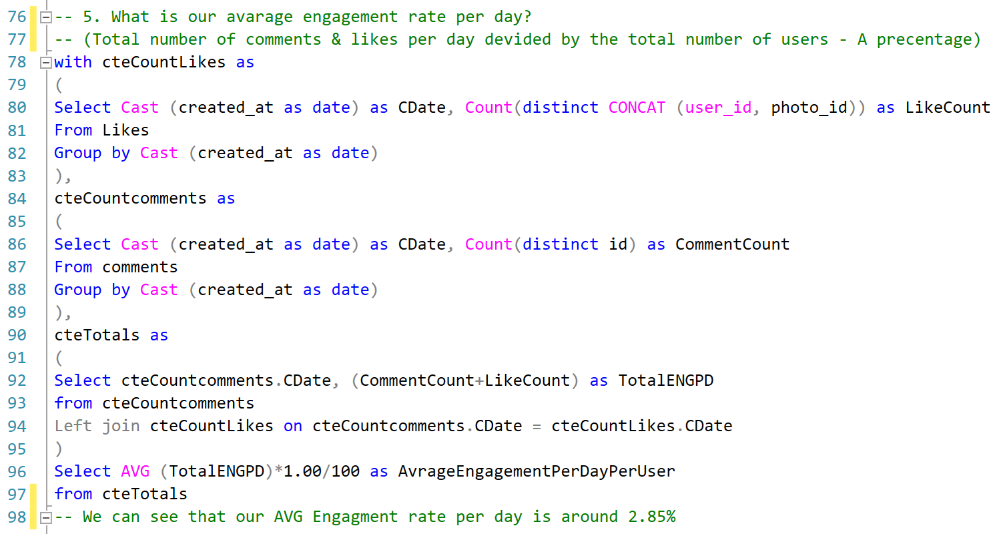


MARVEL Social media ANALISYS
Overall, Marvel’s social media user engagement is very positive with an average engagement rate of about 2.85%, a good social media engagement rate for any influencer/company is considered between 1% - 3.5%
2.85%
Avg. engagement rate

Slide 21
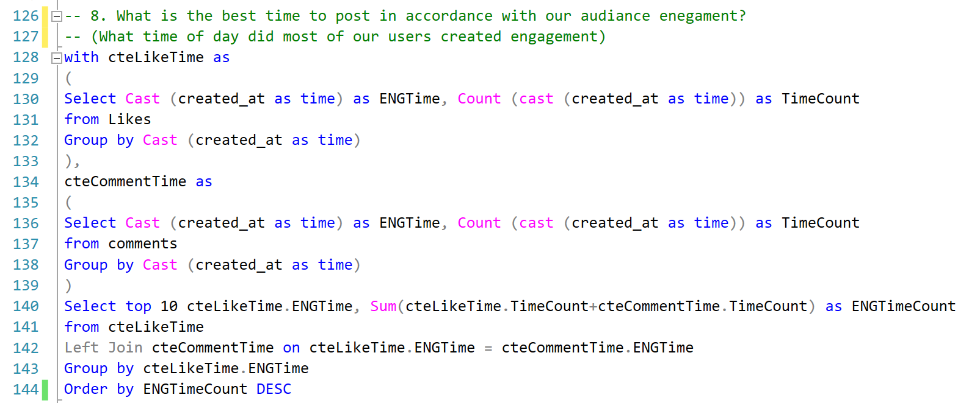
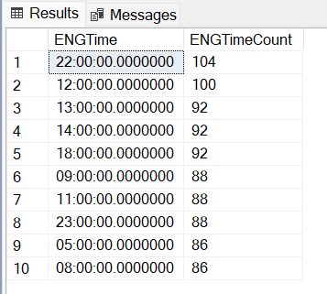

MARVEL Social media ANALISYS
We decided to take that data and create an analysis that might improve Marvel’s engagement. For instance, we looked at what is the best time of day to post in, based on the engagement of this specific tested audience. While the engagement times seem balanced, we do note that between 12:00-14:00 there is a consecutive high engagement time that should work in our advantage.
*This are the top 10 times, there are other times not mentioned in this chart that total in less then 55% precent of the data

Slide 22
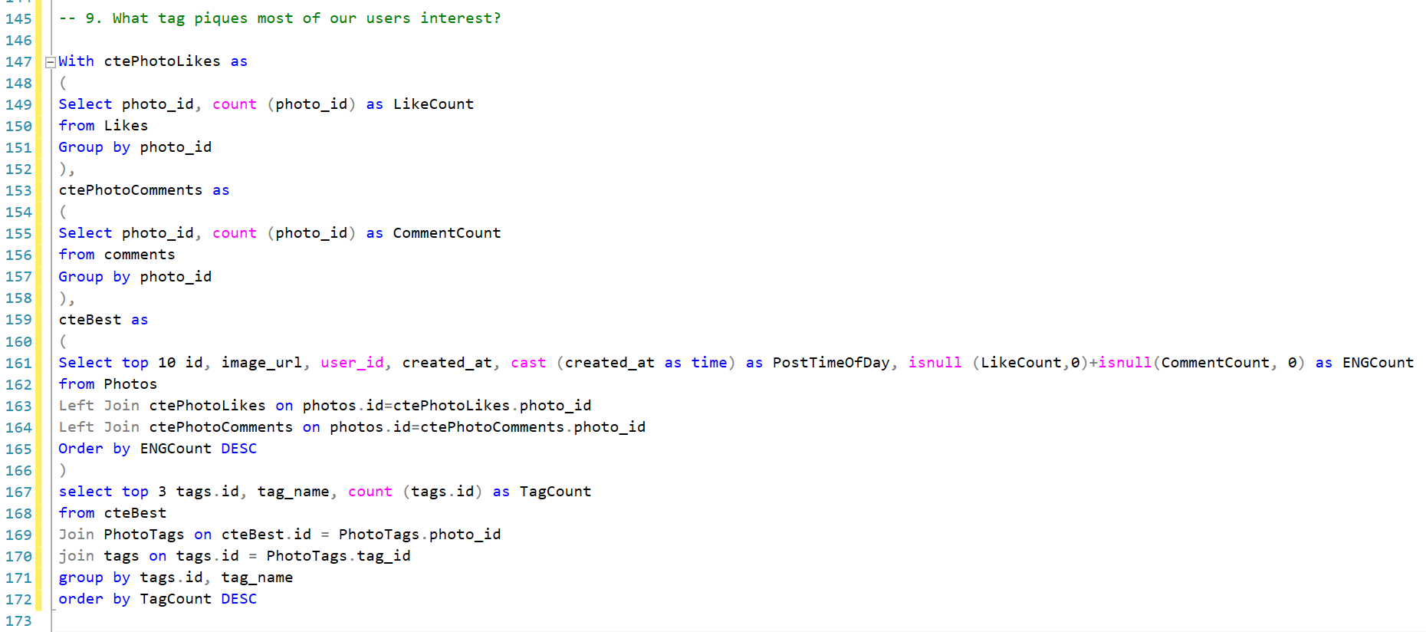
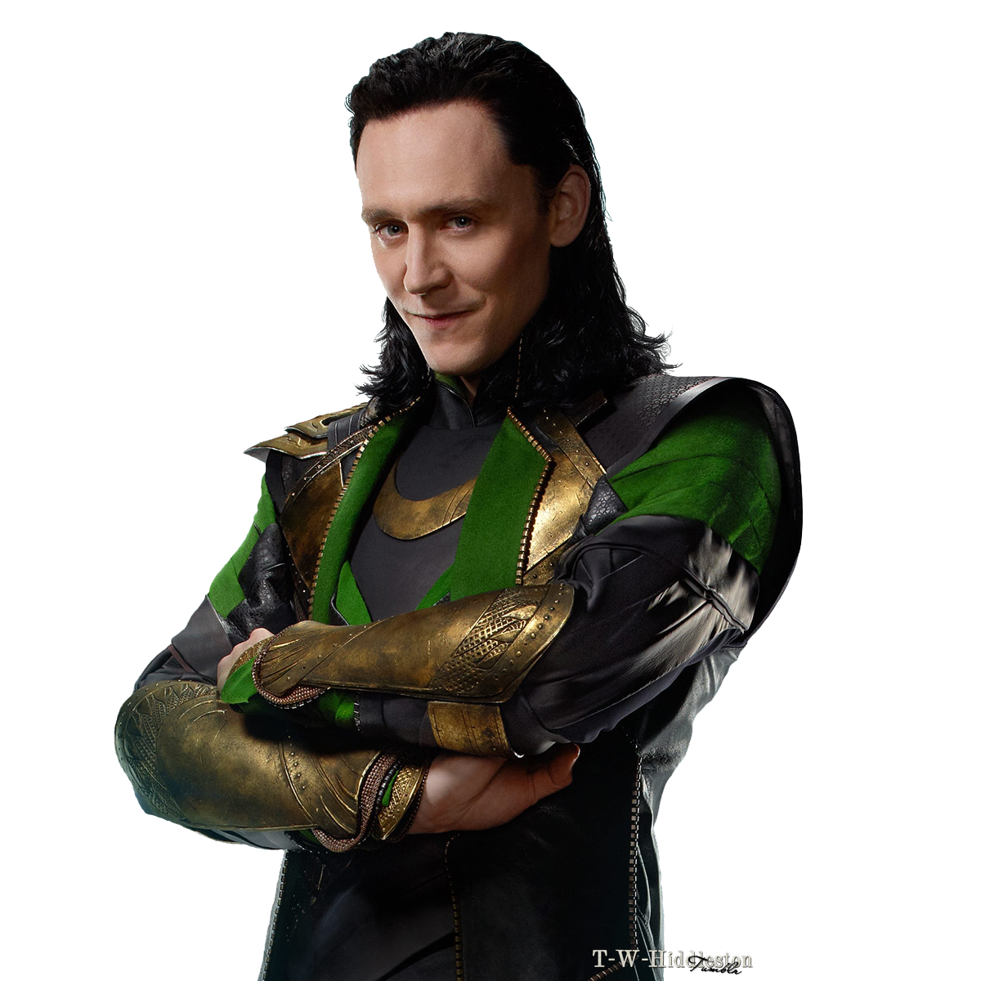
MARVEL Social media ANALISYS
And we also analyzed our crowd’s engagement and attention with specific type of photos, We looked at our 10 most engaged posts and than searched which tags appear the most in those photos.

Slide 23
THANKS !

